Slide 1
The Thames
УМК Spotlight, 10

Slide 2
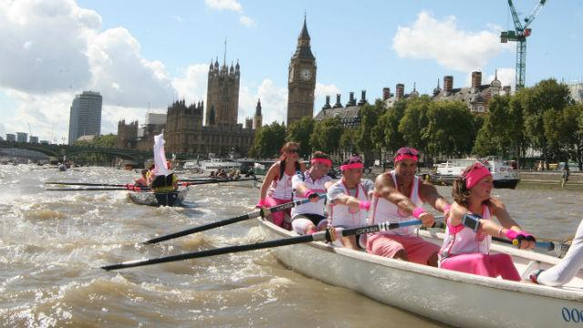
http://www.visitlondon.com/things-to-do/event/43808913-totally-thames#f9eK54iPwzEQwrom.97
About See London’s river Thames brought to life in a month-long season of events at the annual Totally Thames festival.
Walk along the banks of the Thames to see large-scale art installations, exhibitions and live performances. Descend into one of Tower Bridge’s Bascule Chambers for a concert below river-level, or join an archaeological tour of the river's surroundings. See boats of all shapes and sizes cruise down the river, or get on the water yourself with water sports and boat trips.

Slide 3

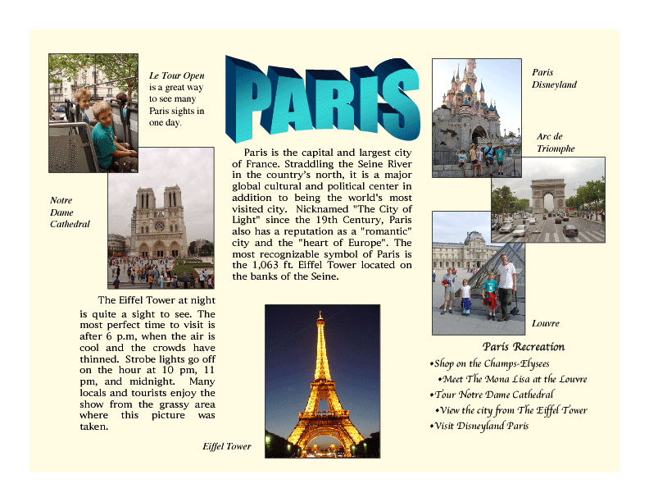
http://images.twinkl.co.uk/image/upload/t_630/image/bb/b4/T-T-12292-Leaflet-Template_ver_2.jpg

Slide 4
Полезные ссылки
http://www.tourismleafletsonline.com/
http://www.visitlondon.com/traveller-information/getting-around-london/london-maps-and-guides/welcome-to-london#rWQFYiMj8ivfZzSM.97

